Slide 1
SENTIMENTAL ANALYSIS
Andres Quintana
Joseph Cardenas
Kavitha Dasaratha

Slide 2
PROJECT OVERVIEW
In today's digital age, text analysis and text mining have become essential parts of various industries. Text analysis refers to the process of analyzing and extracting meaningful insights from unstructured text data. One of the most important subfields of text analysis is sentiment analysis, which involves determining the emotional tone of the text.
Sentiment analysis is the practice of using algorithms to classify various samples of related text into overall positive and negative categories.
In this project we are performing the sentimental analysis for Amazon food review dataset.
20XX
Pitch deck title

Slide 3
PROBLEM DEFINITION
We know that the most of the dataset that is generated today are unstructured. In order to perform the sentimental analysis, we have to preprocess the data, classify and train the model.
The project is broken down into preprocessing and classification
NLP TOOL KIT – DATA PREPROCESSING
NAÏVE BAYES ALGORITHM - CLASSIFICATION
20XX
Pitch deck title

Slide 4
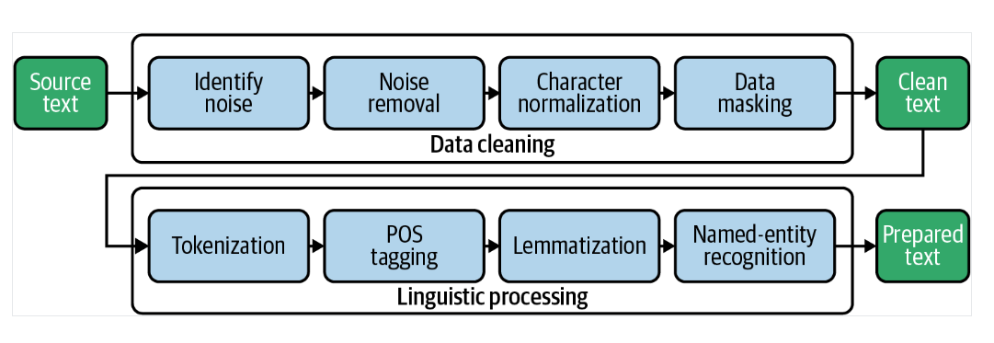
NLP LIBRARIES
Tokenization is splitting the text into words
POS is identifying the parts of speech
Remove stop words
Stemming to reducing the words, it might be meaningful or not
Lemmatization is finding the root words
20XX
Pitch deck title

Slide 5
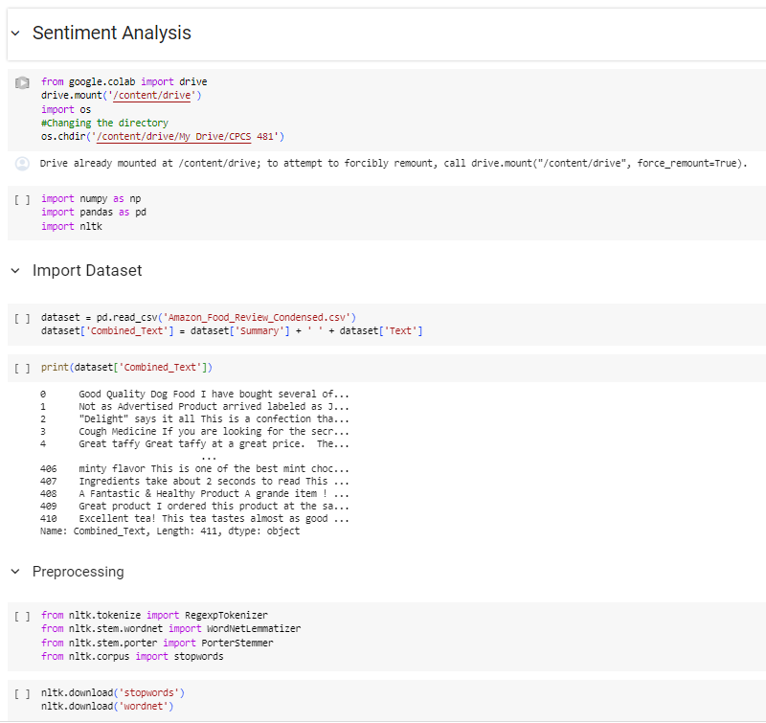
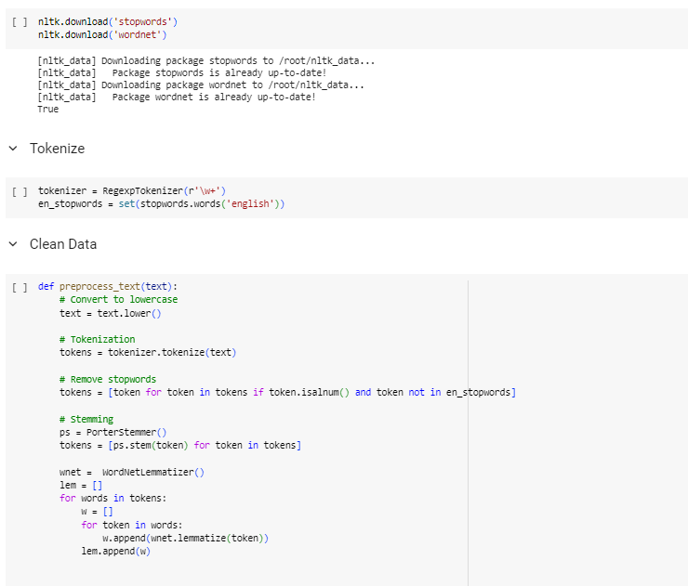
OUTPUT
20XX
Pitch deck title

Slide 6
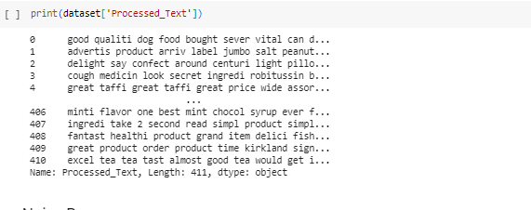
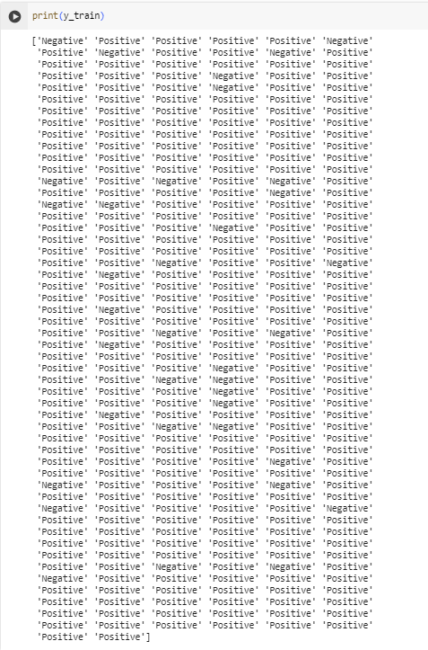
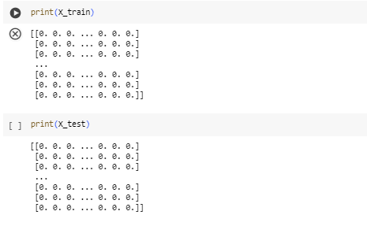
20XX
Pitch deck title

Slide 7
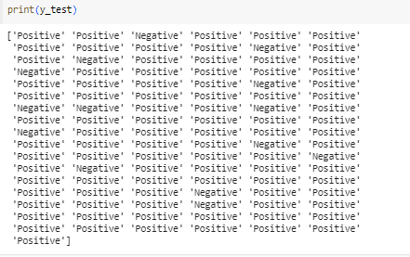
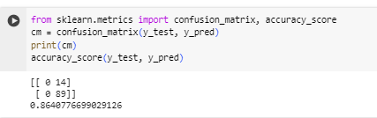
20XX
Pitch deck title

Slide 8
THANK YOU

